Slide 1
Carbon Emissions Analytics Platform - DBMS Term Project
By: Kevin Nyquist, Bahram Afsharmanesh, Austin Downes, and AmirAli Mirian

Slide 2
The Purpose of Our Platform
Consolidate information about various companies and their carbon emissions impacts
Organize and manage different emission sources
Present analytics for companies aiming combat their carbon emissions sources with offsets and carbon sequestration methods

Slide 3
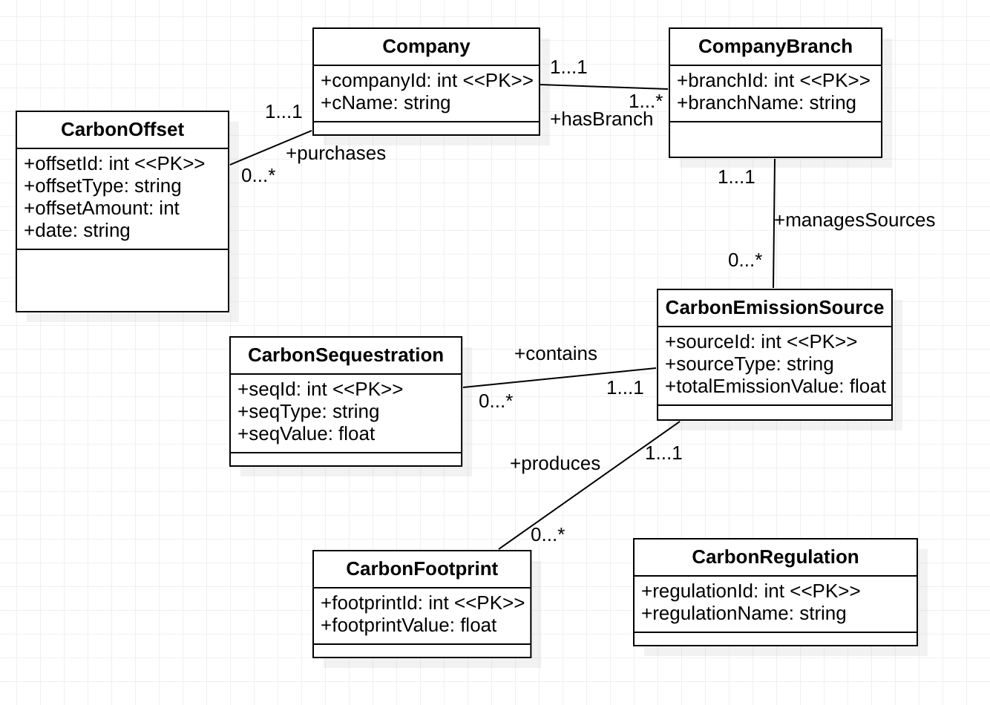
UML

Slide 4
UML to Relational Model
Table 1: Company
companyId: (int) Unique identifier for a company
cName: (string) The company’s name
Table 5: CarbonSequestration
seqId: (int) Unique identifier for carbon sequestration transaction
seqType: (string) Type of sequestration method (carbon capture and storage)
sourceId: (int) Foreign key linked to carbon emissions source
seqValue: (float) Amount of carbon sequestered (in metric tons of CO2)
Table 2: Carbon Offset
offsetId: (int) Unique identifier for carbon offset transactions
companyId: (int) Foreign key identifier linking to a company
offsetType: (string) Type of offset (e.g. renewable energy projects, reforestation, etc.)
offsetAmount: (int) Amount of carbon offset (in metric tons of CO2)
date: (string) Date of the offset transaction
Table 6: CarbonRegulation
regulationId: (int) Unique identifier for carbon regulations or policies
regulationName: (string) Name of the regulation
description: (string) Description of the regulation
Table 3: Company Branch
branchId: (int) Unique identifier for a branch within a company
companyId: (int) Foreign key for the associated company’s id
branchName: (string) The branch’s name
Table 7: CarbonFootprint
footprintId: (int) Unique identifier for carbon footprint
sourceId: (int) Source being assessed for its carbon footprint
footprintValue: (float) Total carbon footprint (in metric tons of CO2)
Table 4: CarbonEmissionsSource
sourceId: (int) Unique identifier for carbon emissions source
branchId: (int) Foreign key linking to branch
sourceType: (string) Type of emission source
totalEmissionValue: (float) Net amount of carbon emissions released (in metric tons of CO2)

Slide 5
BCNF Decomposition
Relations R = { Company(R1), CarbonOffset(R2), CompanyBranch(R3), CarbonEmissionSource(R4), CarbonSequestration(R5), CarbonRegulation(R6), CarbonFootprint(R7), *R8 Added below from superkey*}
Functional Dependencies for Each Relation:
F = { companyId → cName (F1)
offsetId → companyId offsetType offsetAmount date (F2)
branchId → companyId branchName (F3)
sourceId → branchId sourceType totalEmissionValue (F4)
seqId → sourceId seqType seqValue (F5)
regulationId → regulationName regulationDescription (F6)
footprintId → sourceId footprintValue (F7)}
New superkey for decomposition:
regulationId, footprintId, seqId → companyId, name, offsetId, offsetType, offsetAmount, date, branchId, branchName, sourceId, sourceType, totalEmissionValue, seqType, seqValue, footprintValue, regulationName, description
(regulationId, offsetId, footprintId, seqId)+ = R
R8 → Table(regulationId, offsetId footprintId, seqId)

Slide 6
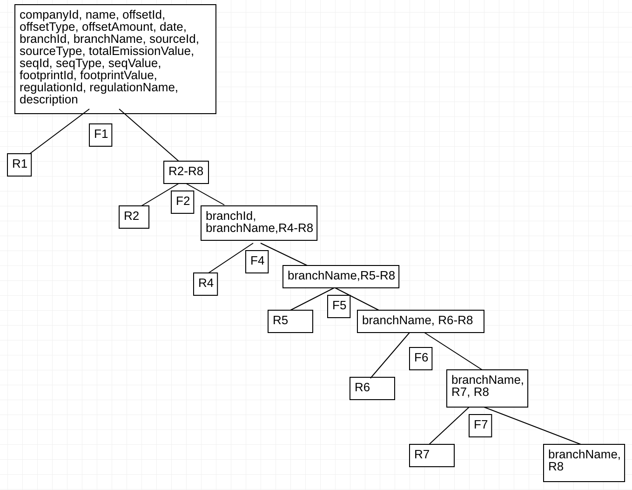
BCNF Decomposition
Table 8 (new):
regulationId: (int) Unique identifier for carbon regulations or policies
offsetId: (int) Unique identifier for carbon offset transactions
footprintId: (int) Unique identifier for carbon footprint
seqId: (int) Unique identifier for carbon sequestration transaction
Final Relations via BCNF:
R1 = {companyId, cName}
R2 = {offsetId, companyId, offsetType, offsetAmount, date}
R3 = {branchId, companyId, branchName}
R4 = {sourceId, branchId, sourceType, totalEmissionValue}
R5 = {seqId, sourceId, seqType, seqValue}
R6 = {regulationId, regulationName, description}
R7 = {footprintId, sourceId, footprintValue}
R8 = {regulationId, offsetId footprintId, seqId, branchName}

Slide 7
3NF synthesis
R = {branchId, branchName, cName, companyId, date, description, footprintId, footprintValue, offsetAmount, offsetId, offsetType, regulationId, regulationName, seqId, seqType, seqValue, sourceId, sourceType, totalEmissionValue}
FDs = {companyId -> cName
offsetId -> companyId, offsetType, offsetAmount, date
branchId -> companyId, branchName
sourceId -> branchId, sourceType, totalEmissionValue
seqId -> sourceId, seqType, seqValue
regulationId -> regulationName, description
footprintId -> sourceId, footprintValue}

Slide 8
Step 1: Apply the minimal cover algorithm on FDs to produce a minimal cover F_{MC}
Singleton RHS
F_{MC} = {
companyId -> cName
offsetId -> companyId
offsetId -> offsetType
offsetId -> offsetAmount
offsetId -> date
branchId -> companyId
branchId -> branchName
sourceId -> branchId
sourceId -> sourceType
sourceId -> totalEmissionValue
seqId -> sourceId
seqId -> seqType
seqId -> seqValue
regulationId -> regulationName
regulationId -> description
footprintId -> sourceId
footprintId -> footprintValue
No extraneous attributes on LHSs: all LHS with < 2 attributes, so it is passed
No redundant FDs
Step 2: Merge all FD X --> Y in F_{MC} that have a common LHS X into a single FD
companyId -> cName
offsetId -> companyId, offsetType, offsetAmount, date
branchId -> companyId, branchName
sourceId -> branchId, sourceType, totalEmissionValue
seqId -> sourceId, seqType, seqValue
regulationId -> regulationName, description
footprintId -> sourceId, footprintValue
Step 3: For each FD, form a Table
R1 = {companyId, cName}
R2 = {offsetId, companyId, offsetType, offsetAmount, date}
R3 = {branchId, companyId, branchName}
R4 = {sourceId, branchId, sourceType, totalEmissionValue}
R5 = {seqId, sourceId, seqType, seqValue}
R6 = {regulationId, regulationName, description}
R7 = {footprintId, sourceId, footprintValue}

Slide 9
Final Relations for 3NF Synthesis
Step 4: Remove any subset tables that are fully contained in some other table
We do not have subset tables in the relations.
Step 5: Check for losslessness: requires closure (Ri)+ = R for some i
Step 6: If it is not lossless, add a new Table that consists of a Global Key
R8 = {footprintId, offsetId, regulationId, seqId}
Final Relations via 3NF:
R1 = {companyId, cName}
R2 = {offsetId, companyId, offsetType, offsetAmount, date}
R3 = {branchId, companyId, branchName}
R4 = {sourceId, branchId, sourceType, totalEmissionValue}
R5 = {seqId, sourceId, seqType, seqValue}
R6 = {regulationId, regulationName, description}
R7 = {footprintId, sourceId, footprintValue}
R8 = {footprintId, offsetId, regulationId, seqId}

Slide 10
Comparing UML, BCNF, and 3NF
All the UML and 3NF designs resulted in successful schema designs because there were no partial dependencies (meaning all of the attributes in each table that aren’t part of the key are functionally dependent on the primary key) or transitive dependencies (meaning there are no attributes that depend on non-key attributes). The BCNF decomposition ensures that these conditions are satisfied because BCNF is a subset of 3NF, meaning it satisfies all of the conditions in 3NF.
The UML and 3NF designs work to prevent anomalies in insert, update, and delete operations because all of the tables have the proper attributes to uphold the relationships between tables (one-to-many, many-to-one, etc). The BCNF decomposition complicates the process of preventing anomalies because the branchName is associated with another table outside of the Branches table. BCNF however does promote data integrity and consistency for the most part with these relations.
The UML and 3NF designs prove to be lossless, preserving all relations so that the data could be reconstructed without any loss of information, but BCNF does not do this. Performing a natural join on the new table (R8) and the new Branch table would not result in the original data because the mappings are not one-to-one.
BCNF and 3NF don’t explicitly guarantee dependency preservation, and in this scenario, only the UML and 3NF designs maintain their functional dependency relationships between attributes. The BCNF decomposition results in the loss of the branchId -> companyId, branchName FD, resulting in branchName being left out of the branches table.
In conclusion, UML and 3NF were chosen as the better designs for our tables.

Slide 11
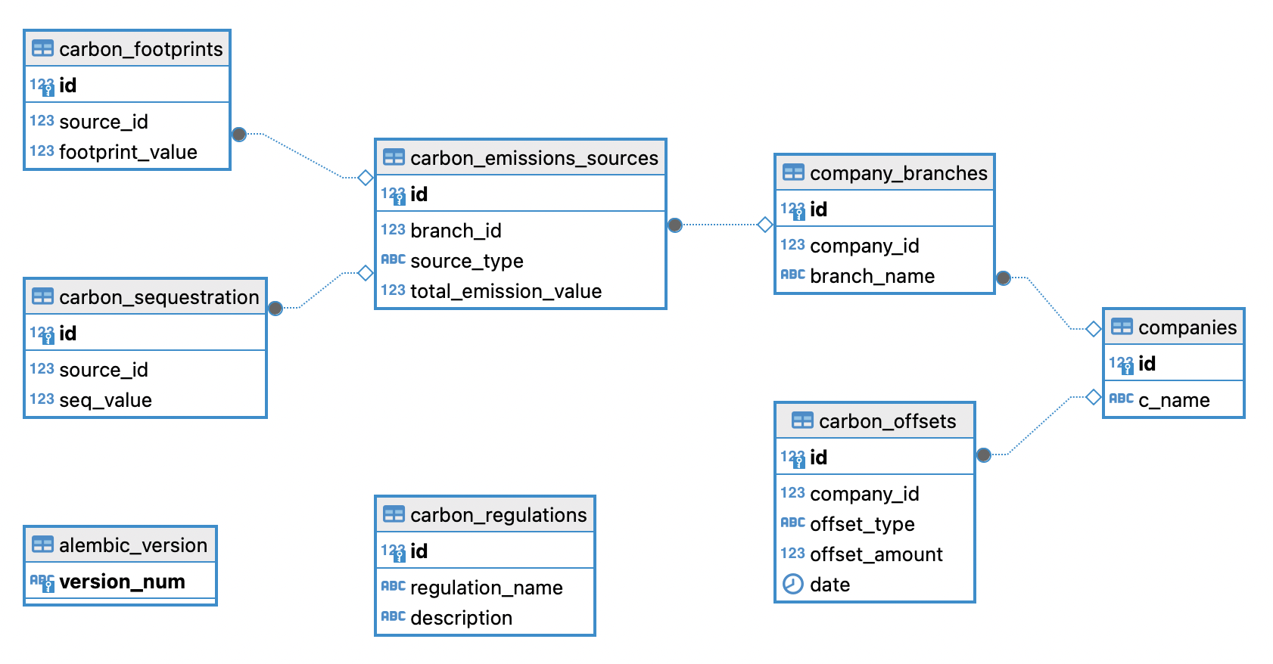
The Final Schema
7 Primary keys (one for uniquely identifying a the rows in each table), 5 Foreign keys (enforcing multiplicities)
Property constraints of these relationships are defined to cascade delete related items, preventing orphaned data in the database

Slide 12


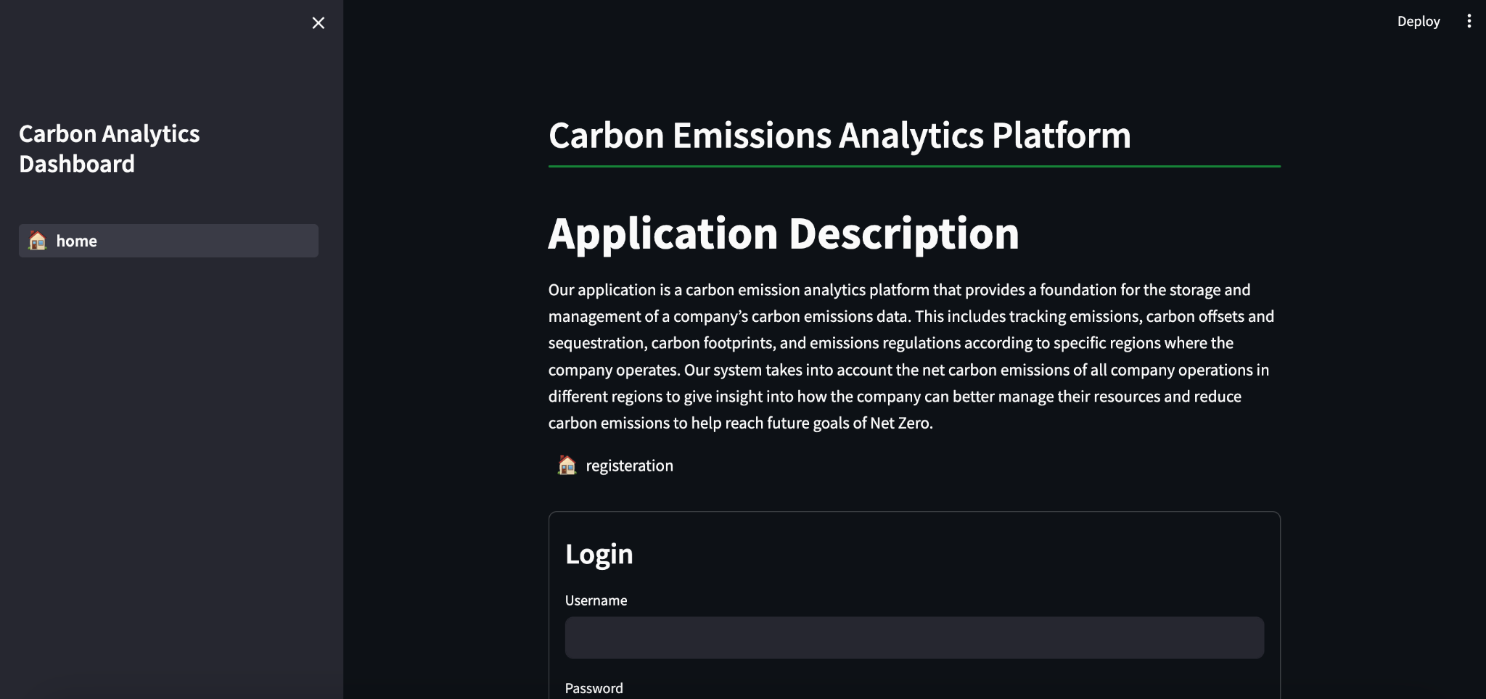
Software Architecture and Components
Database
PostgreSQL
Backend
Framework: FastAPI
ORM: SQLAlchemy
Migration Tool: Alembic
Data Validation: Pydantic
Frontend
Streamlit

